Slide 1
Root Cause Analysis
U5 – Analyse
E3 – Analytical Methods
The element ‘Analytical Methods’ describes the tools that can be used for risk analysis, root cause analysis and waste identification.
Yellow Belt
Notes:
Welcome to the root Cause Analysis module of the Lean Six Sigma in Healthcare module.

Slide 2
Root Cause Analysis
Problem Solving
Symptom → Problem → Root Cause → Solution
Symptom
A symptom is a characteristic or complaint belonging to a specific problem
Problem
A deviation of expectation; an unexpected effect with unknown causes
Symptom
fighting
Problem
solving
What are we going to do?
Notes:
When problem solving it is important not to spend a lot of time fighting symptoms. Instead, it is important to concentrate on solving the root cause of the problem. A ‘problem’ is defined as a deviation from the normal situation, of which the cause might still be unknown. A ‘symptom’ is the characteristic of the underlying problem, in practice this is often a customer complaint.

Slide 3

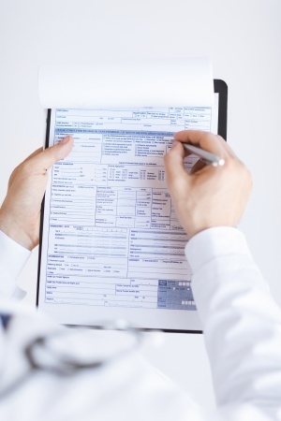



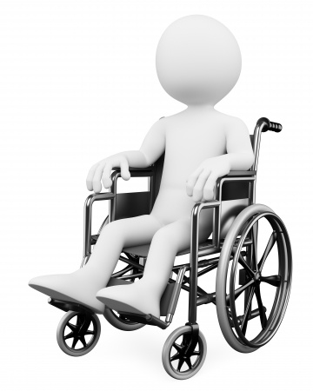
Root Cause Analysis
Symptons and causes
Nurse gives wrong dosage
Bloods tests lost
Patient late for scan
Doctors writing is illegible
Laboratory has no storage system
Wheel chair not in its location
Notes:
If we try to find the causes of the symptoms on this list, we might find the related problems shown here. We probably would not have found all the root causes for these symptoms. For example, is the nurse gives the wrong dosage it is because the doctors writing is illegible.

Slide 4
Root Cause Analysis
8D Problem solving
Today
D1 – Establish team
D2 –Describe problem
48
hours
D3 – Develop interim containment actions (ICA)
D4 – Identify & verify root cause
D5 – Identify permanent corrective actions (PCA)
Couple
of days
D6 – Implement & validate the PCA
D7 – Prevent recurrence
D8 – Congratulate the team
Notes:
Here we can see an overview of the eight steps within the 8D technique used to solve problems. First, a team is put together that has enough experience and authority to permanently solve the problem. This team then creates an adequate problem description and a short term solution to prevent escalation of the problem. After this, the team needs to find the true root cause of the problem and find a permanent solution. A good control plan assures that this problem doesn’t occur again in the future. The management of the company must also be sure to thank the team for their efforts.

Slide 5
Root Cause Analysis
Describe the problem
Describe the problem as objectively and clearly as possible:
What IS
What IS NOT
IS - IS NOT you consciously think about the problem, specifically, the boundaries of what the problem IS or IS NOT
IS NOT
Differences
IS
Root cause
Changes
Notes:
5
A good way to analyze problems is with what is called the IS/IS NOT technique. This is a good preparation tool for a team to use when starting to analyzing the potential causes of a problem. With this technique, we approach the problem by deciding the boundaries of what the problem IS or IS NOT.

Slide 6
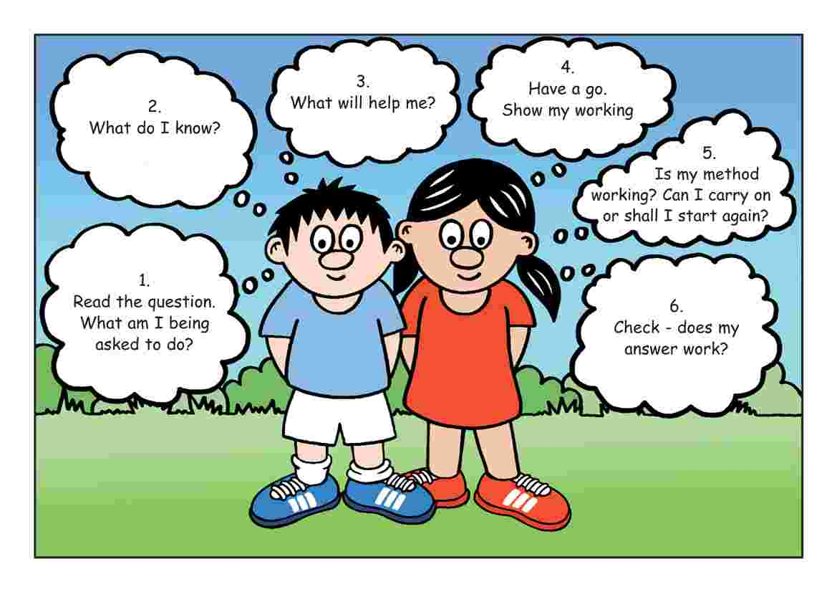
Root Cause Analysis
Is – Is not
Why is there a problem and why not?
Where is the problem and where not?
What occurred and what did not?
When did
the problem occur
occur and when not?
Who is affected and who is not
How often did the problem occur and to what extent?
5W2H
Notes:
Some questions to ask when employing the IS or IS NOT technique is “What occurred and what did not?”, “Who is affected and who is not?”

Slide 7
Root Cause Analysis
Is – Is not
Comparison Analysis
Differences: What is special, unique or different in terms of what IS vs. what IS NOT?
Changes: In relation to the differences, what has changed?
Possible Causes
Events that explain how the problem is caused
Which changes could have caused the problem?
Be creative and use if necessary “brainstorming”
Notes:
7
By looking at comparison analysis –the differences and changes, it is possible in Is-IS NOT analysis to establish possible causes.

Slide 8

Root Cause Analysis
Brainstorming
Brainstorming is a group creativity technique designed to quickly generate a large number of ideas for the solution of a problem
Ground rules:
Withhold criticism
Focus on quantity
Think ‘outside-the-box’
Notes:
Brainstorming is a technique that can be used during 8D problem solving to generate ideas concerning potential causes of a problem. The goal of the team is to come up with as many different ideas as possible. It is important therefore, not to criticize any ideas during brainstorming. Everybody should feel free to propose out-of-the-box ideas. Building on each other’s ideas should also be encouraged.

Slide 9
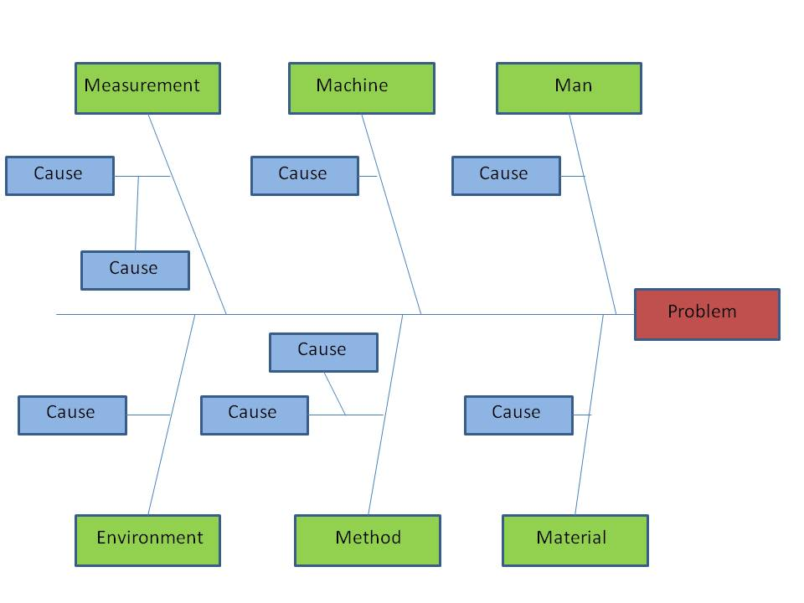
Root Cause Analysis
Cause & effect diagram
Also called:
Fishbone diagram
Ishikawa diagram
This diagram clearly displays all factors that contribute to a problem
It helps to identify relationships between possible causes and problems and to identify data that needs to be collected and analyzed
Notes:
One technique that is often used to analyze problems is called an Ishikawa, fishbone or cause-and-effect diagram. Here, the problem is presented in the head of the fish and the potential causes of the problem are displayed on the 6 different fish bones called Machine, Men, Measurement, Method, Material and Environment. By doing this, all of the potential causes are systematically studied and we can prevent the risk of forgetting causes. The diagram also offers the possibility to elaborate and prioritize certain causes.

Slide 10
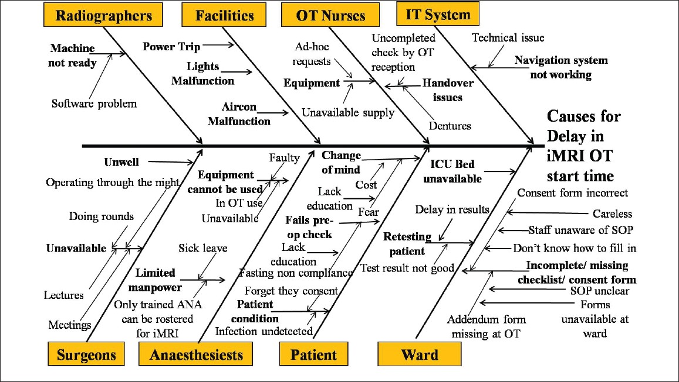

Root Cause Analysis
Example Cause & effect diagram
A C&E diagram used to brainstorm reasons for delays in MRI scan starting times
123RF Stock Photo
Notes:
Here can we see an example of an Ishikawa diagram developed for the delays in an MRI scan. The diagram shows many different causes that might contribute to a delay in the scan. The different causes are presented on the bones of the fish.

Slide 11
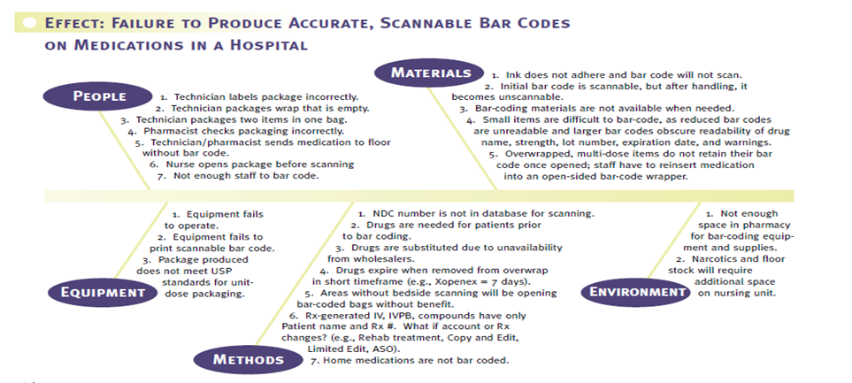
Root Cause Analysis
Example Cause & effect diagram
Failure to produce accurate, scannable bar codes on medical medications
Notes:
A second example of a Cause & Effect diagram to brainstorm the reasons for inaccurate barcodes on medical mediations.
In this diagram, the priority is not yet indicated. Also, no further elaboration has yet taken place. This we can do using a technique that will be explained on the next slide.

Slide 12

Root Cause Analysis
The 5-Why
The 5-Why method is not an individual tool, it is part of the whole problem solving toolbox
It is similar to the Fishbone brainstorming tool
The 5-Why has to answer three questions:
Why did the problem occur?
Why was it only detected at the customer?
Why did “the system” not function?
Notes:
The 5-Why technique is often used when we need to solve problems structurally. The technique involves repeatedly asking for underlying causes, using the ‘why’ question. One needs to continue asking the question ‘why’ until the root cause of the problem is discovered. The three questions one needs to answer are: why did the problem occur, why was the problem only detected at the customer and why did our quality system fail?

Slide 13
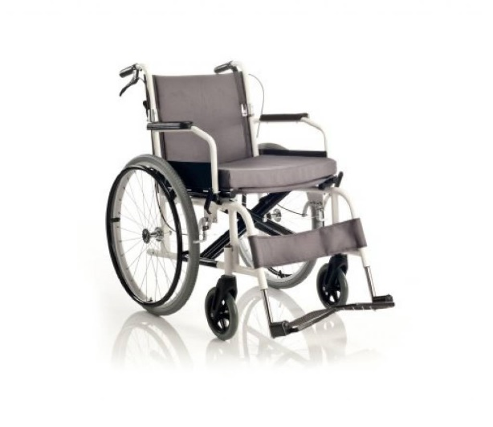
Root Cause Analysis
Example 5-Why: Patient late for therapy
Why was the patient late at the therapysession in the rehabilitation centre, causing delays?
There was a long wait for a wheelchair
Why was there was a long wait for a trolley?
Because a replacement wheelchair had to be found
Why did a replacement trolley have to be found?
Because the original wheelchair was worn and had eventually broken
Why was the original trolley's safety rail worn and broken?
Because it had not been regularly checked for wear
Why had it not been checked regularly for wear?
Because there is no equipment maintenance schedule
Notes:
An example of a 5-Why is shown here to brainstorm why a patient is late for therapy.

Slide 14
Root Cause Analysis
Example 5-Why: Patient late for therapy
Solution
Setting up a proper maintenance schedule helps ensure that patients should never again be late due to faulty equipment.
This reduces delays and improves flow. If you simply repair the wheelchair, the problem may happen again sometime in the future.
Notes:
The solution to the patient being late in this case was to address a problem in relation to wheelchair maintenance.

Slide 15
Root Cause Analysis
The 5-Why
Use 5-Why technique (ask 5 X WHY)
Why did it occur?
Causes
Root cause
A)
Effect
Why not detected?
Causes
Root cause
B)
Why quality system failure?
Causes
Root cause
C)
Notes:
With this we have come to the end of this Yellow Belt training module. We have demonstrated several techniques that can be used to solve problems, such as the 8D, the 5-Why and the Ishikawa or fishbone diagram. By using these, a problem can be analysed deeply enough, to be able to find and solve its root cause. In this way, the problem will not occur again in the future.

Slide 16
Root Cause Analysis
Example 5-Why: Patient late for diagnostic test
Why are patients arriving late? The porters/ transporters are not called on time*
Why?
Nurses are busy and often forget
There is no written request
No protocol for contacting porters/transport
Why are patients arriving late? Porter is unable to locate patients*
Why?
The contact request does not include patient location (name only)
No standard protocol for porter paging
Why are patients arriving late? Patient not ready for transport*
Why?
Nurses unaware of prescribed test
No mechanism to inform RN of scheduled procedure
* Indicates there may be more than one root causes of the problem!
Notes:
Another example of a 5 Why is shown above –where a patient is late for a test. It can be seen that there is more than 1 root cause for the issue.

Slide 17
Root Cause Analysis
Proposed solution
The team investigating delayed transport of patients to diagnostic departments discovered that the root cause was:
A lack of clear protocol for communicating between the diagnostic department, RN of the clinical department and the transporter/ porter
Proposed countermeasures:
A new protocol where the diagnostic department pages the charge RN and the transporter at the same time (thus eliminating the nurse as the intermediary)
Specified information content of pages
New patient prep procedures involving both the RN and the transporter/ porter
Notes:
Proposed solutions and countermeasures can then be put in place once the root cause has been discovered using 5 Whys.

